Slide 1
Blockchain Taxonomy
Source of most materials:
Xiwei Xu, Ingo Weber, and Mark Staples. Architecture for Blockchain Applications. Springer, 2019

Slide 2
Outline
Taxonomy definition
Blockchain taxonomy
(De)centralization
Consensus protocols
Ledger structures
Mining & ledger distributions
Notes:
First, we’ll discuss what a taxonomy is.
Then we discuss a set of classifications like decentralisation, consensus protocols, auxiliary blockchains that supplement an existing blockchain, and different ledger structures. The textbook includes a few other classifications.

Slide 3
Taxonomy

Slide 4
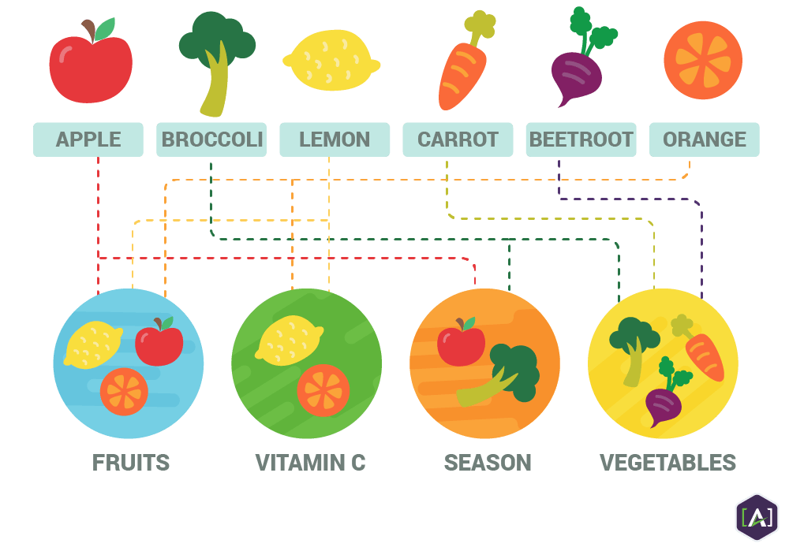
Taxonomy
Practice & science of classification of things or concepts, including principles that underlie such classification
Diverse range of blockchains has emerged
Complex internal structures, many variants, & configurations
Difficult to compare & contrast
Blockchain taxonomy
Dimensions & categories for classifying blockchains
Enhance understanding by
Exploring conceptual design space
Compare & evaluate design options
Assess their impact on quality attributes
Notes:
Taxonomy is the practice and science of classification of things or concepts, including the principles that underlie such classification.
Here we see different classifications as fruits and vegetables. They are also classified based on whether they contain vitamin C and whether they are seasonal (growing or harvest) fruits and vegetables.
Fruit and Vegetable can be classified based on botanical characteristics. Fruit is a seed-bearing structure that develops from the ovary of a flowering plant. Vegetables are all other plant parts, like roots, leaves, and stems.
While taxonomies are used heavily in biology and zoology, they have also been used in software architecture to understand existing technologies.
A diverse range of blockchains has emerged without much detail on their internal designs, product data, or performance. Given their complex internal structures, many variants, and configurations it is difficult to compare and contrast them.
A taxonomy on blockchains defines dimensions and categories for classifying blockchains and ways of using them in systems.
The presented taxonomy captures major architecturally-relevant characteristics of various blockchains and indicates their support for various quality attributes. It was informed by existing industrial products, technical forums, academic literature, and our own experience of using blockchains and developing prototypes.
Such a taxonomy eenhances understanding by:
Exploring conceptual design space as building application on blockchain need to consider features and configuration.
Comparing and evaluate design options.
It can help consider impact of different design decision on quality attributes for the overall system.

Slide 5
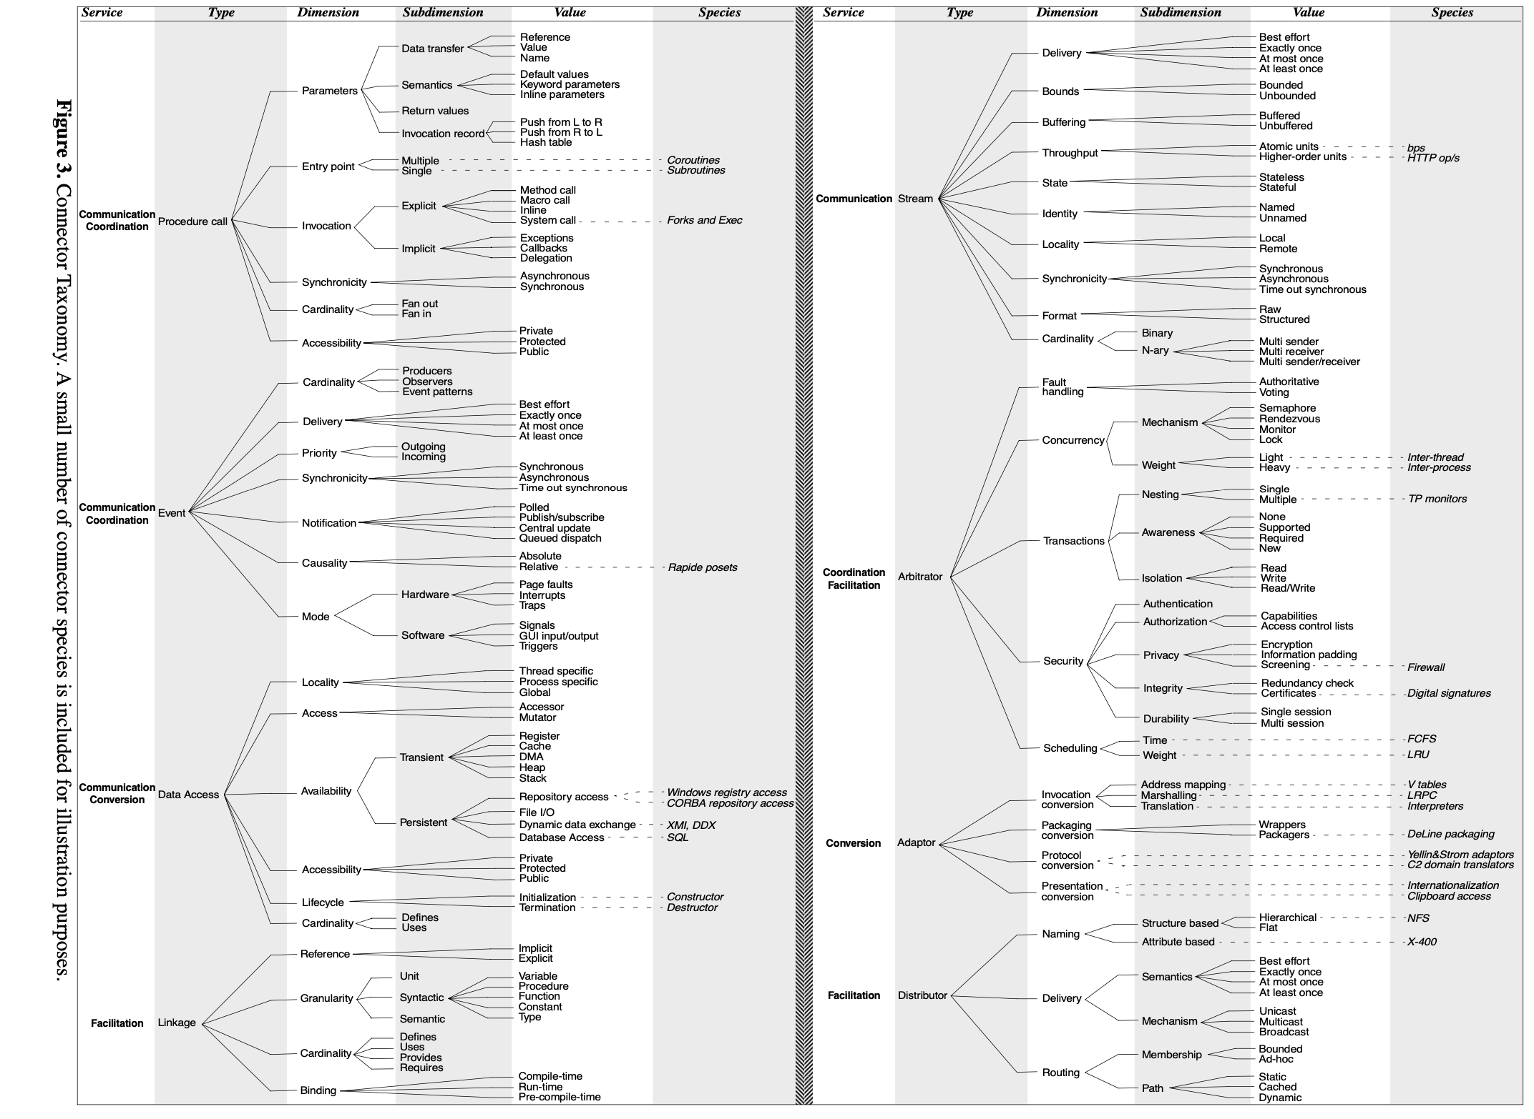
Software Connector Taxonomy
Source: Mehta et al., “Towards a taxonomy of software connectors”, In Proc. 22nd Intl. Conf. on Software Engineering, June 2000.
Notes:
Here’s a taxonomy from a paper that presents a comprehensive classification framework and taxonomy of software connectors.
Software connector is the fundamental building block of software architecture that deals with the interaction between software components.
The taxonomy proposed in the paper can be used both to understand existing software connectors and to propose new software connectors that can fill the gaps within the state of the art.
The diagram on the left shows the overall view of the software connector taxonomy. Organized in a tree structure.
The diagram on the right zoom into the sub-tree about the stream software connecter. As we can see that the taxonomy uses 10 different dimensions to further classify the steam software connectors.
For example, in terms of delivery, there are 4 values representing the connecter uses best effort strategy, the connector delivers exactly once or delivers at most once or at least once.
In terms of buffering, some connectors buffered the data packages, some don’t. And in terms of state, some connector is stateless, while others need to maintain the state.
Such taxonomy proposed in the paper can be used both to understand existing software connectors, facilitate the selection of existing software connectors, and propose new software connectors that can fill the gaps within the state-of-art, for example, by exploring different combinations of the possible values of different dimensions.

Slide 6
Taxonomy: A Glimpse – Classification
 | Permissionless | Permissioned
Public | Consensus: Proof-of-X Permission management Blockchain layer Application layer (optional) Incentive: Blockchain layer | Consensus Proof-of-X PBFT, Federated consensus, Round Robin, etc. Permission management Blockchain layer Application layer (optional) Incentive: Blockchain layer Governance around permissions
Private | Consensus Proof-of-X PBFT, Federated consensus, Round Robin, etc. Permission management: Blockchain layer Network layer Application layer (optional) Incentive: Governance around access | Consensus Proof-of-X PBFT , Federated consensus, Round Robin, etc. Permission management: Blockchain layer Network layer Application layer (optional) Incentive: Governance around access permissions
Notes:
The following 2 slides give a much-simplified classification, which is represented by a 2 by 2 matrix.
4 categories based on 2 dimensions: public/private and permissioned/permissionless
Compared based on 3 aspects, including consensus protocol, permission management, and incentives.
Permissionless-public (Bitcoin & Ethereum).
These blockchains are the most widely known, where everyone can join the blockchain network to submit and validate transactions without permission.
Permissioned public (Ripple and Avalanche)
These blockchains are public but need permissions to validate transactions and build blocks. However, the information stored on such a blockchain is publicly accessible to all the participants.
Permissionless private (Ethereum on a private network)
Is a rare option, but is still technically possible, where the blockchain is deployed within a private network environment. People within that network environment don’t need extra permission to join that blockchain network.
Permissioned private (Hyperledger Fabric and R3 Corda)
These blockchains are also widely used in business, where the blockchain is deployed within a private network environment. Organizations need to get permission to join the network. A private-permissioned blockchain can better protect data privacy and confidentiality because the blockchain is not deployed publicly, accessible to all that have internet access.
In terms of consensus protocol, the permissionless blockchain normally use some form of Proof-of-X consensus protocol, like proof-of-work used by Bitcoin and proof-of-stake in Ethereum 2.0.
The other 3 categories can use both proof-of-X and BPFT Byzantine practical fault-tolerant protocol, federated consensus, or round robin.
Permission management in private networks usually involves a firewall.
Incentive in permissionless public: transaction fee and block reward.
Private blockchains, including both permissionless and permissioned private blockchains, rely on governance around access permissions.

Slide 7
Taxonomy: A Glimpse – Quality Tradeoffs
 | Permissionless |  | Permissioned
Public | Immutability Integrity Transparency Availability Performance Cost Efficiency | +++ (#Nodes, Consensus, Topology) +++ (#Nodes, Consensus, Topology) ++ (Access control) +++ (#Nodes, Topology) + (Consensus, latency) + | Immutability Integrity Transparency Availability Performance Cost Efficiency | ++ ++ ++ ++ ++ ++
Private | Immutability Integrity Transparency Availability Performance Cost Efficiency | + + + + +++ +++ | Immutability Integrity Transparency Availability Performance Cost Efficiency | + + + + +++ +++
Notes:
Matrix shows the impact of these 4 categories of blockchain on quality attributes.
Number of pulses represents how well the quality is compared with other alternatives.
Aspects in brackets are the aspects of the blockchain that affect the quality.
Among the 4 categories, permissionless public blockchain has the best immutability, but the worst performance and cost efficiency.
Immutability and integrity are good due to the size of the network. The larger size of the network, the more computational power provided by the whole network and the more difficult for a single party to attack the blockchain network or change the data stored on the blockchain.
The consensus protocol used by a blockchain can also affect the fundamental properties provided by a blockchain. For example, proof-of-work can provide the best immutability in general since it is nearly impossible for a single participant within the blockchain network to host enough computational power to control the how blockchain network.
Transparency is affected by access control.
Availability is mainly affected by the number of nodes within the blockchain network.
Performance is worse due to latency caused by consensus on a large network.
Cost is worse due to the cost associated with the maintenance and management of a large network.

Slide 8
Decentralisation

Slide 9
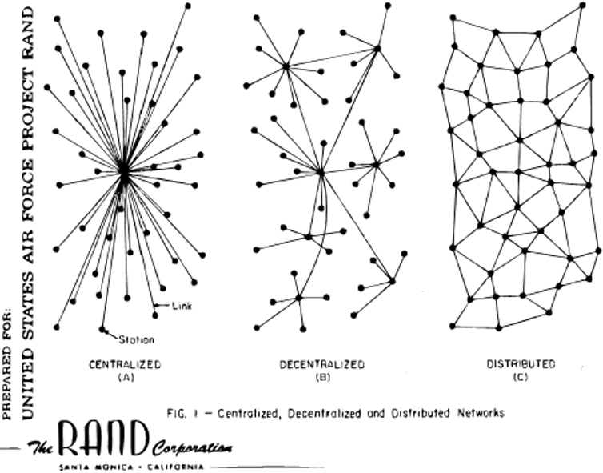
Decentralisation
Centralised systems won’t survive a targeted attack
Even with reliable hardware, software, & networks
A distributed configuration can achieve highly reliable systems
With unreliable hardware, software, & networks
Blockchains/DLTs are either decentralised or distributed
Notes:
This is a diagram from Paul Baran, “On Distributed Communications Networks”, IEEE Transactions on Communications Systems, Vo. 12, no. 1, March 1964, which proposed a distributed system for the management of missile networks in the USA.
It considered survivability in the cases of enemy attacks directed against nodes, network links, or combinations of nodes and links.
Figure A and B are the telecommunication provider approach at that time. Even though such designs include reliable hardware, software, and networks they won’t survive targeted attacks.
Paul Baran proposed the idea that a distributed configuration can achieve highly reliable systems even with unreliable hardware, software, and networks.
This has led to the development of a network to manage the missile system in the USA, which eventually became the Internet.
Some blockchain designs are decentralised (most private-permissioned blockchains) while others are distributed (most public blockchains).

Slide 10
ISO 22739:2020 Terminology – Distributed vs Decentralised
Distributed system
“System in which components located on networked computers communicate & coordinate their actions by interacting with each other”
Terminology covers decentralised & distributed designs in RAND project figure
Decentralised system
“Distributed system wherein control is distributed among persons or organisations participating in the operation of system”
“Note 1 to entry: In a decentralised system, distribution of control among persons or organisations participating in the system is determined by its design”
Decentralised systems are distributed systems with distributed administrative control
Notes:
ISO 22739:2020 Blockchain and Distributed Ledger Technologies standard’s terminology discusses the distributed and decentralised slightly differently (this may not be consistent with the textbook which came out before ISO definition).
Distributed systems here cover decentralised and distributed designs in the RAND project figure in the previous slide.
ISO takes the view that decentralised systems are distributed systems with distributed administrative control. Whereas many distributed systems can be under a single administration.

Slide 11
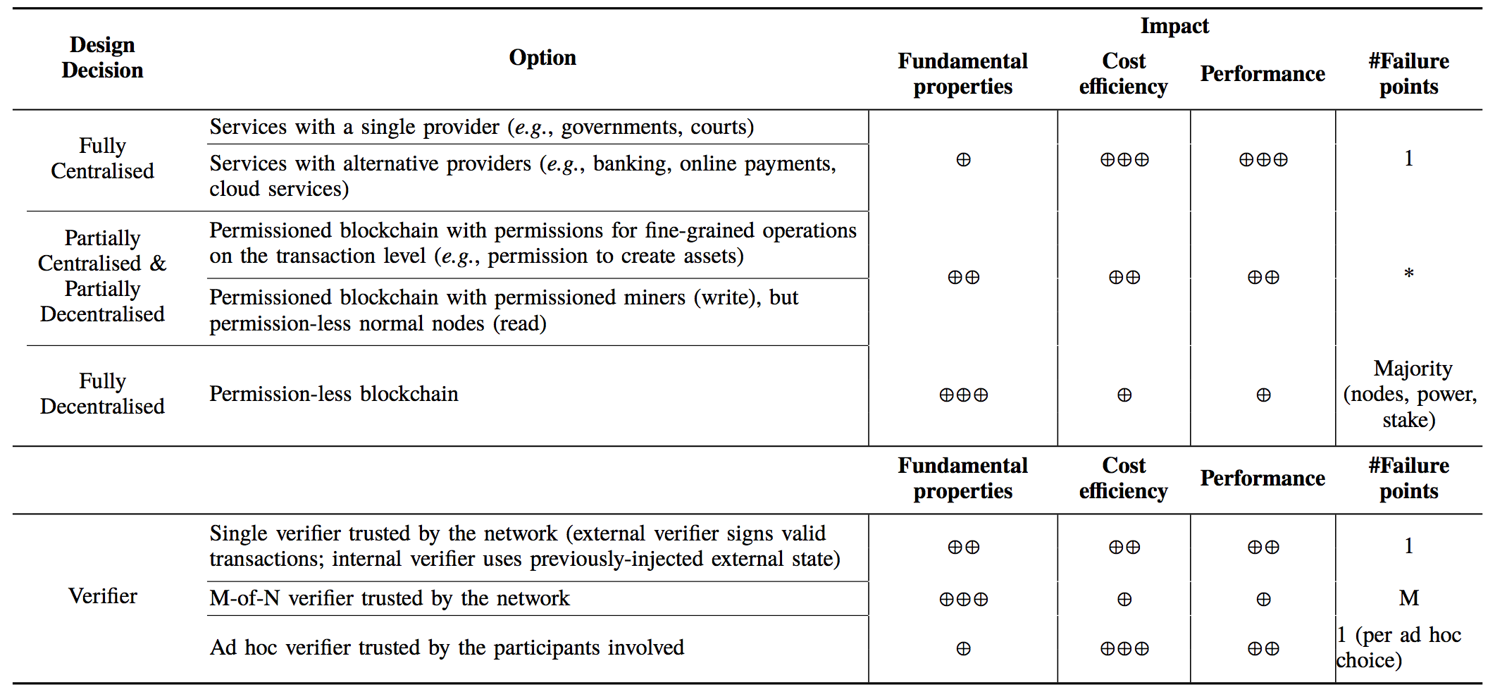





Centralisation vs Decentralisation
Notes:
Decentralisation is one of the key design aspects of blockchain technology. It devolves responsibility and capability from a central location or authority.
In a centralised system, all users rely on a central authority to mediate transactions. For e.g., in a bank, customers rely on the bank’s systems to correctly adjust their account balances after a bank transfer.
Manipulate the whole system: updating backend databases, or upgrading the software happen under a single administrative entity
This leads to a single point of failure for the whole system → minimised through geographical replication.
A fully decentralised system allows people to reach an agreement on who owns what without having to trust each other or a separate third party.
Such a design is highly available, for e.g., as every full node in Bitcoin has a full copy of the blockchain and processes every transaction.
There is a spectrum of possibilities between centralisation and decentralisation.
Ripple – has a centrally selected 100 nodes. Monax – claims to be the 1st permissioned blockchain.
Hyperledger Fabric is not quite fully decentralized. Kafka-based ordering service (before ver 2.0) for a crash fault-tolerant ordering service is not fully decentralized. Raft-based ordering service introduce in ver 1.4 gets closer to having a decentralized network. The eventual plan is to have a fully decentralized Fabric network when the BFT (byzantine fault tolerance) ordering service

Slide 12
Full Centralisation
Centralised data & administrative control
Services with a single provider
E.g., governments, courts, business monopolies
Single point of failure
Services with alternative providers
E.g., telcos, banking, online payments, cloud services
Switch or use multiple providers simultaneously
Failure of a single service provider or business failure affects its users
E.g., When a mobile payment company goes bankrupt & switches off the servers, all customers are affected
Notes:
Centralised data and administratively centralised control. Data may be physically distributed, but still under a single authority's control.
Monopoly service providers, including governments and courts within a jurisdiction, and business monopolies.
Single point of failure for its users.
There’s no choice than getting these providers to enhance their availability and fault tolerance.
Competing alternative providers, such as banks, online payments, or cloud computing providers.
Users have a choice and may switch providers or may be able to use multiple providers simultaneously. Need to make sure these providers are independent, e.g., while there are many mobile service providers there are only 3 mobile networks at hardware level (Telstra, Optus, and Vodafone).
Failure of a single service provider only affects its users.
However, business failures are also possible, e.g., when a company behind IoT devices goes bankrupt and switches off the servers, all devices stop working.
So, the failure could be technical or business-related.

Slide 13
Full Decentralisation
Decentralised data & administrative control
Permissionless public blockchains
Most blockchains logically centralises data
Completely open
New users can join, validate TXs, or mine/validate blocks at any time
Could be across jurisdictional boundaries undermining regulatory controls
Need protection against Sybil attacks
Sybil attack - where an attacker subverts a service's reputation system by creating many pseudonymous identities & uses them to increase their influence
PoW – Total amount of computational power rather than number of nodes is important for integrity
51% attack possible by accumulating massive computing power, but very costly
Notes:
In these systems both data and administration are decentralised.
Permissionless public blockchains are completely open: new users can at any time join the network, validate transactions, and mine/validate blocks.
While Bitcoin and Ethereum come under this classification they logically centralise data as every node has the same data. Ethereum 2.0 was trying to decentralise data with sharding.
Decentralised systems use anonymous validators to protect against Sybil attacks, where attackers create many hostile anonymous nodes.
A Sybil attack is an attack on a computer network service in which an attacker subverts the service's reputation system by creating many pseudonymous identities and using them to gain a disproportionately large influence.
Bitcoin’s proof-of-work (PoW) mechanism doesn’t focus on the total number of nodes for its integrity but rather on the total amount/volume of computational power.
Same idea with Ethereum 2.0’s Proof of Stake, where you rely on validators setting aside 32 ETH.
A decentralised system can be defeated if there is a majority of authority (nodes, computational power, or stakeholding). E.g., in the 51% attack, the attacker accumulates more computing power (or stake) than the rest of the network.
Game-theoretic attacks can change this threshold, requiring a higher (e.g., 66%) majority to maintain integrity.

Slide 14
Partial (De)centralisation
Partially centralised data & administrative control
Permissioned blockchains require authorities to act as a gatekeeper
Permission to join the network (read)
Permission to initiate TXs (write)
Permission to build blocks
Permissioned blockchain with permissions for fine-grained operations
Permission to create assets
Permissioned blockchain with permissioned miners/validators (write), & permission-less nodes (read)
New users can join & validate TXs, but can’t mine/validate blocks
Notes:
These systems partially centralised data and administrative control. They may be called either partially centralised or partially decentralised.
A blockchain may be permissioned in requiring that one or more authorities act as a gatekeeper for participation.
The permissions may include the ability to read ledger data, write data into the ledger, and build blocks.
Based on this, some designs allow reads to anyone while writing only to a selected set of users. Others require permission to read, write, and mine (i.e., build blocks).
Permission information can be stored either on-chain or off-chain.
The code for public blockchains can also be deployed on private networks to create a kind of permissioned blockchain using network access controls.
Permissions can be at different levels, e.g.,
Permissions for fine-grained operations such as creating tokens.
Permission to mine/validate blocks while anyone being able to read data.

Slide 15
Partial (De)centralisation (Cont.)
More suitable in regulated industries
Control on who can mine
E.g., Know-Your-Customer (KYC) regulations require establishing real-world identity of transacting parties
Knowing a party establishes some level of trust
E.g., overcoming Sybil attacks
At least, legal system as backstop
Enhanced trust reduces need for extreme consensus protocols & large number of miners/validators
High-performance & efficient blockchains/DLTs
Permissioned nodes may still get attacked leading to misbehaviour
Still need some number of nodes. Question is how many?
E.g., Byzantine Fault Tolerance (BFT) based protocols use 3f + 1 nodes to guard against f failures
Notes:
Because of the permissions, decentralised networks are more suitable for regulated industries.
There’s control over who can read, write, and mine. Mining (aka block validation in proof of stake protocols) is perhaps the most important as they determine what persists on the ledger.
When you have control over who can mine, like KYC in banking, it establishes some level of trust.
E.g., at least Sybil attacks can be avoided because a party can’t create so many pseudo accounts/nodes to get disproportionate control of the system.
Even if such technical solutions are limited or failed, knowing a party, we can rely on the legal system as a backstop.
Through this enhanced trust, we can avoid the need to have extreme consensus protocols like PoW with Nakamoto consensus and reduce the number of miners/validators needed to prevent attacks that may accumulate/combine many nodes.
Relatively small networks with efficient consensus protocols lead to high-performance and efficient networks.
However, even the permissioned nodes may misbehave, e.g., the node may be attacked or run by a crooked owner. So, you would still need some number of nodes. However, it’s not straightforward to determine the number of nodes you need.
E.g., Byzantine Fault Tolerance (BFT) based protocols use 3f + 1 nodes to guard against f failures.

Slide 16
Consensus Protocols

Slide 17



Consensus Protocol
Miners generate new blocks & propagate to peers in blockchain network
Miners encounter different competing new blocks
Different sets of TXs in a block
Multiple solutions to PoW puzzle
Network delays
Miners resolve this using consensus mechanism
Consensus mechanism impacts TX finality
Notes:
At the start of each round, miners build a block and propagate that to the rest of the network as soon as possible.
In the meantime, there’s a possibility other miners may also build a block with a different combination of transactions.
In PoW, even for the same set of transactions included in the block, there can be different solutions for the PoW puzzle.
Even when a miner builds a block and propagates that to the network, it takes time to propagate that block to most of the nodes in a network due to network delay. In the meantime, other miners will continue to build blocks.
So, we need a mechanism to resolve which block to be accepted as included in the chain of blocks among these completing blocks for the same block number.
This is achieved using a consensus mechanism.
The chosen consensus mechanism has an impact on the TX finality.

Slide 18
2 Main Families of Consensus Mechanisms
Nakamoto Consensus
New block/TX is final when it’s on the “biggest” chain we have seen so far
Probabilistic finality
Can get orphans/uncles
Don’t need to know how many nodes are there (> 1,000 ok)
Supermajority
New block/TX is final when I have seen evidence that > 2/3 of nodes agree
Conventional finality
Like normal database TXs
Need to know how many nodes there are (~10–100 nodes ok)
May know there are different parties
Notes:
Consensus mechanisms/protocols can be broadly classified into 2 families.
We have already seen the Nakamoto consensus.
A new block and its transactions are final when it’s on the “biggest” chain we have seen so far.
The biggest is in terms of computing power.
The term “Biggest” is more appropriate than “longest”, as blockchains like Ethereum include uncle blocks (predecessor blocks that are not in the longest chain) to increase the weight of a block, making a block carry more computation behind.
Whether a block is included in the longest chain or nor depends on the probability of an alternative longer chain appearing. With time, this probability goes down as more and more blocks are added to the current longest chain.
When a TX can’t be reverted, we consider it to be final. Hence, TX finality is probabilistic in Nakamoto consensus-based blockchains.
A typical assumption in Bitcoin is to wait for 6 blocks along the same chain of blocks after a TX is included in a block, as it is probabilistically quite unlikely to be no longer in the longest chain (probability is never zero). Likewise, Ethereum 1.0 used wait for 10-12 blocks. However, there are cases where waiting for a few blocks is not enough if you need a very high-level of assurance.
E.g., In 2013, Bitcoin forked due to a bug in one version of the software but not another version, leading to part of the network rejecting a chain that was accepted as dominant by the other part. The split was resolved after 6 hours. Also, due to an attack in 2010, ½ day worth of blocks were reverted. Ethereum DAO attack is another example.
If a block is no longer in the longest chain, we call it an orphan block (usually in Bitcoin). Such blocks in Ethereum that are later referred to by a successor block are called uncles.
These protocols don’t need to know how many nodes are there, and 1,000s of nodes are common.
More nodes mean more computing power, which is handled through automatic block difficulty adjustment based on inter-block time. If the inter-block time of the last few blocks is low, the difficulty is increased. If inter-block time increases, the difficulty is reduced.
Other family of protocols rely on some form of supermajority votes.
New block/TX is final when I have seen evidence that > 2/3 of nodes in the network agree.
This achieves finality in the conventional sense where a transaction is final as soon as it’s included in a block that achieves super majority, e.g., like normal database transactions.
However, to determine the supermajority, we need to know how many nodes there are in the network (these networks typically have 10 to a couple of 100s of nodes).
These nodes may also know there are different parties in the network.
Knowing exactly who is in a distributed network is hard. Hence, generally, network is static and nodes know at least the total no of nodes is are supposed to be in the network.
The supermajority used for voting could be a subset of all known nodes. For e.g., in Ethereum 2.0, for each epoch, 32 nodes are randomly picked to attest on a block.
Side note – Finality
After a transaction is complete if the stated asset owner (e.g., payment recipient) can claims it's legally theirs we consider the transaction to be “final”.
In information systems point of view, this means once the transaction is recorded it will not change.
However, there is no system in the world that offers truly 100% settlement finality in the literal sense of the term. Even on a paper-based asset registry, one can change an entry by flipping letters. This is much easier on a computer system with one or a few replicas. Also, acts of god can lead to the loss of physical and electronic records…

Slide 19

Proof of Work (POW)
Nodes compete for the right to create next block by solving a hash puzzle
Extremely difficult to solve, easy to verify
Takes effectively random time
Prob (winning next block) = Fraction of global hash power miner controls
Energy intensive, high latency
Electricity consumption of Bitcoin is compared to countries/cities, e.g., Turkmenistan & Las Vegas
Probabilistic finality
Put PoW for good use
Primecoin generates prime number chains which are of interest to mathematical research
Notes:
As we have discussed so far, PoW miners compete for the right to create a block by solving a hash puzzle, e.g., Bitcoin and Ethereum 1.0.
To create a block, a miner needs to find a nonce that makes the hash of the concatenation of the strings (nonce plus block header data) meet a certain difficulty level, e.g., a given no of leading zeros.
Hashing functions are uni-directional, making it extremely difficult to solve, and easy to verify a given answer
Hence, the only way to find a nonce that solves the hash puzzle is to try a large enough number of nonces until you get lucky; hence, it takes a random time effectively.
The more computing power you throw into solving the puzzle by trying out multiple nonce values at the same time (i.e., parallelly) determines your chance of solving the puzzle.
Therefore, the probability of finding a matching nonce is proportional to the fraction of the global hash power the miner controls.
Given the massive amount of computing resources you need to solve the hash puzzle, this process is extremely energy intensive.
For e.g., the electricity consumption of Bitcoin is compared to countries like Turkmenistan or cities like Las Vegas.
Due to probabilistic finality, you must wait for some time to be sure that the TX is included in the biggest chain with high probability.
Blockchains like Primecoin try to put the work done in solving PoW puzzle to good use. Primecoin generates prime number chains which are of interest to mathematical research.

Slide 20
PoW (Cont.)
Answer is difficult to compute, but easy to validate
Hashcash in Bitcoin & Ethash in Ethereum
No shortcuts, must try all possible answers
Difficulty of problem is automatically adjusted with time
Overcomes increasing computing power to maintain average inter-block time
Miners use specialised hardware to try multiple nonces at once
ASICs in Bitcoin & GPUs in Ethereum
See https://youtu.be/x9J0NdV0u9k
n-bit nonce
m-bit block data
+
Try another nonce
Hash()
0000xxxxxx
Accept if l 0s in prefix
(aka block difficulty)
Notes:
We have already seen this slide.
Once a set of pending transactions are included in a block, miners need to solve a puzzle to build a block. Once they solve the puzzle only they can announce/propagate/broadcast the new block into the network.
This puzzle is called Proof of Work (PoW) as it is difficult (computationally expensive, costly, and time-consuming) to solve the puzzle but easy for others to verify the answer. This is more like you solve a problem by spending an hour, while your teacher can verify your answer in seconds.
Bitcoin miners solve a puzzle called hash cash to build a valid block. Ethereum used an algorithm called Ethash (Ethereum 2.0 doesn’t use PoW).
PoW algorithms like hashcash are “embracingly parallel problems” with no shortcuts to finding the answer.
The diagram outlines the basic idea:
On one side you have the data that reflect the content of the block header like Merkle root, previous hash, and timestamp.
The bitcoin block header is 80 bytes including a nonce, i.e., m = 80 – 4 = 76 bytes.
On the other side, you have the nonce, a large random number.
In Bitcoin nonce is 32-bits (i.e., n = 4 bytes) and the resulting hash value is 256 bits.
You concatenate the 2 and calculate the hash value.
You then check whether the resulting hash value satisfies a certain properly. E.g., For here we check whether the hash has 4 zeros as the prefix. Such a hash is called a valid hash and the associate block is called a valid block.
In practice, the acceptance threshold can be more specific like a very large number.
The acceptance threshold is adjusted over time to ensure the average inter-block time remains 10-min with increasing computing power.
If not, you must retry again while changing the nonce. You can't change the m-bit data, as it reflects the content of the block. If you want to do that you have to do more work than just trying another nonce.
There's no easy way to guess what nonce would work. So you must try nonce values until you get lucky.
Hence, quite a massive number of hashes need to be tried before finding a hash value that satisfies the acceptance threshold. Thus, the process is computationally expensive and consumes lots of power.
While it's difficult to find what nonce work, easy to validate whether a given nonce satisfies the condition.
Just concatenate the claimed nonce with the block header, calculate the hash, and check whether the hash value satisfies the acceptance threshold.
The difficulty of the problem is automatically adjusted with time to overcome increasing computing power to maintain average inter-block time.
A simple adjustment would be to increase/decrease the number of leading zeros in the hash. But a finer control can be achieved by adjusting the massive number that is hash value is expected to satisfy.
Bitcoin – Every 2,016 blocks (approximately 14 days given roughly 10 minutes per block), nodes deterministically adjust the difficulty target/threshold.
Ethereum – Difficulty is adjusted every block.
This essentially means more computation the BC network put into solving the puzzle, and the difficulty of the puzzle gets increased, increasing the time to solve the puzzle. That way we can retain an average ~10-min inter-block time target.
Miners use specialised parallel hardware to speed up the process by computing multiple nonce values parallelly:
ASIC – Application-specific integrated circuit
GPU – Graphics processing units
As of April 2022, it takes on average 122 sextillion (122 thousand billion billion) attempts to generate a block hash smaller than the difficulty target.
The actual mechanism may slightly change from the given figure, e.g., instead of changing nonce on the block, miners may add a random value to coinbase TX to keep changing the block header until block difficulty is achieved. See https://en.bitcoin.it/wiki/Mining

Slide 21

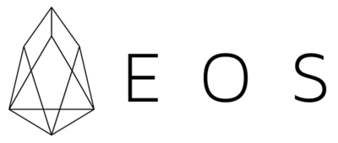

Proof of Stake (POS)
Select next mining node based on the control of native cryptocurrency
Align incentives of cryptocurrency holders with good operation
Add some randomness to prevent selecting only miners with the largest stake
More cost-efficient, low-latency
Delegated Proof-of-Stake
Accounts delegate their stake to other accounts rather than participating in the TX validation
Bitshare
Representatives take turns in a round-robin manner to build blocks
Notes:
In proof of stake (PoS), miners (mostly called validators) are selected in proportion to their quantity of holdings in the native cryptocurrency.
A validator with a higher stake has a high chance of building a block. This idea is that such validators have stronger incentives to make sure the network operates as expected. Otherwise, their assets are at risk of losing value.
Some randomness is added to the selection of validators to prevent selecting only miners with the largest stake.
PoS is more cost-efficient and has low latency. However, it’s considered to be not as secure as PoW.
Peercoin was the 1st blockchain to introduce PoC. It’s used in many other blockchains such as Cardano, Algorand, Avalanche, Polkadot, Tron, and EOS.
Delegated Proof-of-Stake (DPoS) is a sub-variant where account delegate their stake to other accounts rather than participating in the transaction validation.
DPoS is considered to be less secure due to the centralisation of validators, as only a few validators act on behalf of others.
Bitshare is a DPoS blockchain where representatives take turns in a round-robin manner to build a block.

Slide 22
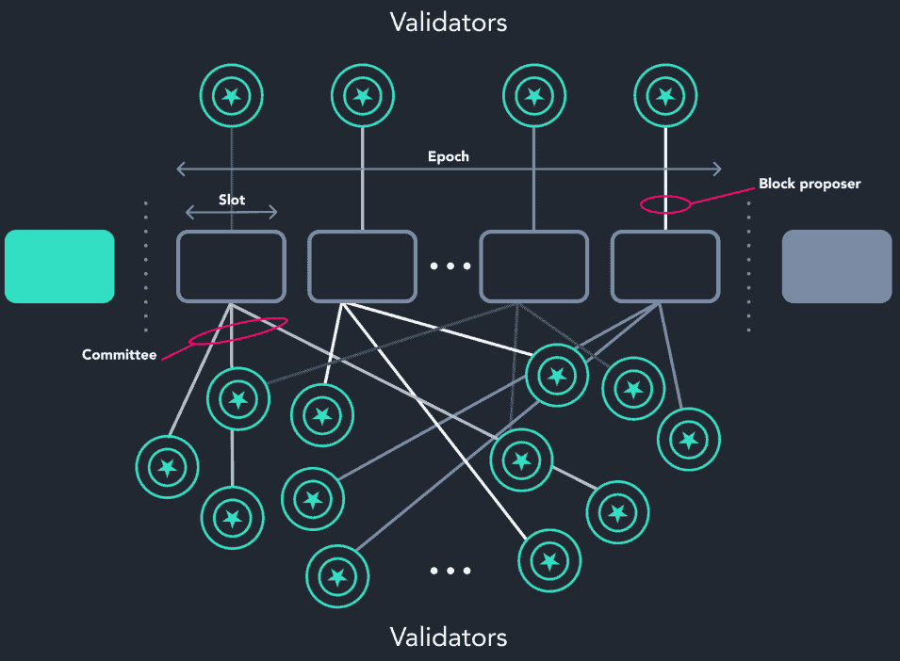
PoS in Ethereum 2.0
Nodes become validators by staking 32 ETH
Stake is reduced if no show when called upon
Stake is slashed if build an invalid block
12 sec slots, 32 slots for epoch
A randomly selected validator proposes a block for the slot
A committee of validators is also selected randomly & votes for the proposed block
All validators vote for pairs of checkpoints
1st block in epoch is a checkpoint
If a pair of checkpoints attracts votes representing >= 2/3 total ETH staked, checkpoints are upgraded
Source: https://www.bloxstaking.com/documents/eth2/
Notes:
PoS in Ethereum 2.0 is quite complicated. Here we take a very simplified view, see https://ethereum.org/en/developers/docs/consensus-mechanisms/pos/ for some more details.
A node becomes a validator (miners in Ethereum 2 are called validators) by staking 32 ETH to a smart contract.
Validator will lose part of the stake is if no show when called upon to build a block, i.e., being off-line when they are supposed to propose a block.
The stake is slashed if the validator builds an invalid block as determined by the majority of other validators. Some consider this to be like burning down one’s PoW computing farm/warehouse.
Time in proof-of-stake Ethereum is divided into slots (12 seconds) and epochs (32 slots).
One validator is randomly selected to be a block proposer in every slot.
A committee of validators consisting of 128 is also selected randomly and votes on the proposed block. A block is valid if the majority of them agree on the proposed block’s validity.
All validators vote for pairs of checkpoints (1st block in the epoch is called a checkpoint).
If a pair of checkpoints attracts votes representing >= 2/3 total ETH staked, checkpoints are upgraded.
The more recent of the two (target) becomes "justified". The earlier of the two is already justified because it was the "target" in the previous epoch. Now it is upgraded to "finalized”.
Thus, you need to wait for 2 epochs to achieve finality in Ethereum 2. Thus, the time to finality in Ethereum 2 is higher than Ethereum 1.

Slide 23
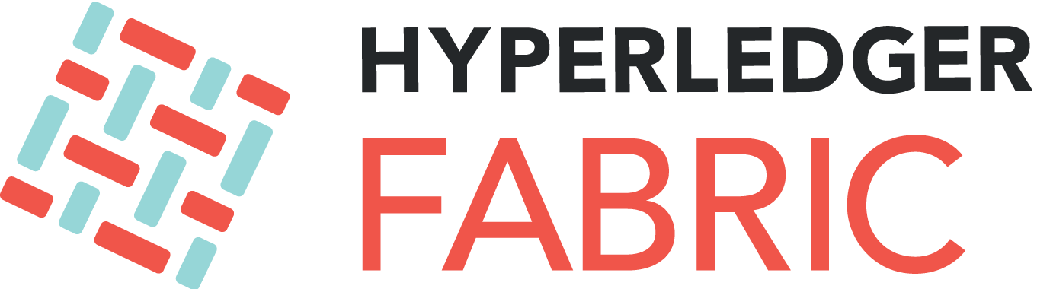

Proof of Authority (PoA)
Known nodes are assigned block building role
Attached reputation of an identity incentivises good operation
Ensures consensus despite arbitrary behaviours from a fraction of participants
More conventional approach within distributed systems
Validators may work as a group or elect a leader
Small number of validators → Centralisation
High throughput & lower latency
Authority becomes a target for attackers
Used in permissioned blockchains
A few 10s of nodes max
All participants agree on who will be in the network
Notes:
In PoA-based networks, transactions and blocks are validated by approved/known accounts, known as validators.
With PoA, individuals earn the right to become validators. Hence, there is an incentive to retain the position that they have gained. By attaching a reputation to identity, validators are incentivised to uphold the transaction process, as they do not wish to have their identities attached to a negative reputation.
It can be seen as a consensus model with identity at stake
This is a more conventional approach within distributed systems where the validator role may be upheld by all nodes or a leader may dynamically elected to validate transactions and blocks on behalf of other validators.
However, the network has only a small number of validators making the consensus process centralised.
PoA provides high throughput and lower latency as TX finality is immediate and small size of the network.
However, there’s a high risk of authority getting compromised as it’s an easy target for attackers.
Therefore, PoA is typically used in permissioned blockchains and validators are well-guarded.
All participants agree on who will be in the network, e.g., to add a new order to an existing order network in Hyperledger Fabric, the existing order should approve that TX.
Hyperledger Fabric is moving toward BFT-based consensus (see next slide).
Another PoA DLT is R3 Corda.
You can also run existing public blockchains under PoA consensus, e.g., Quorum and Hyperledger Besu are based on Ethereum and can use PoA consensus.

Slide 24


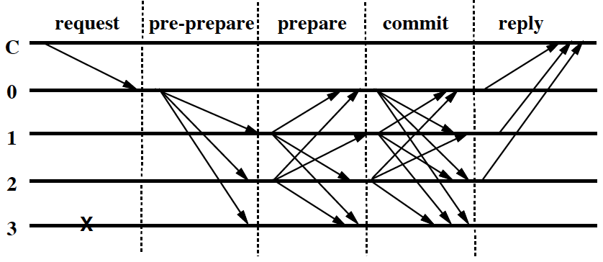
Practical Byzantine Fault Tolerance (PBFT)
Recent consensus algorithms based on Byzantine Fault Tolerant (BFT)
Use a known set of block validators
New block is created every x seconds
Each block must be confirmed by 2/3 majority
High throughput & lower latency
Used in permissioned blockchains
Use 3f + 1 nodes to guard against f failures
All participants agree on who will be in the network
10s to a few 100 nodes
Known attack if some validators misbehave
Source: M. Castro and B. Liskov, “Practical Byzantine Fault Tolerance”, 3rd Symposium on Operating Systems Design and Implementation, Feb. 1999
Notes:
Byzantine Fault Tolerance(BFT) is the feature of a distributed network to reach consensus even when some of the nodes in the network fail to respond or respond with incorrect information (i.e., either fail or misbehave).
The objective of a BFT mechanism is to safeguard against system failures by employing collective decision-making (both – correct and faulty nodes), which aims to reduce to the influence of the faulty nodes.
Practical Byzantine Fault Tolerance (PBFT) protocols are a subclass of BFT protocols that work in asynchronous networks, i.e., with no assumptions about network delay (whereas BFT protocols have strong assumptions about network delay and do not work across the Internet).
PBFT has been applied for consensus in permissioned blockchains, e.g., Stellar, Tendermint, VMware Concord, and RedBelly.
They use a known set of block validators/nodes to build and confirm blocks.
A new block is created every x seconds (or no block is emitted if there are no transactions), and each block must be confirmed by a 2/3 majority.
As we can see from the figure:
Once a TX is submitted by a client (C), it goes into one of the nodes (called primary).
The primary then broadcasts the transaction to all other validators (called replicas) – called the pre-prepare step.
A validator validates the transaction and replies its valid/invalid decision to the primary node – Prepare step.
Once a sufficient no of positive votes is received (usually 2/3 majority), primary broadcast all other validates to commit the transaction – commit step.
Then only all nodes update the ledger.
The client is notified by each validator so that the client can verify a majority of the network executed the TX and update the ledger state.
Then for the next round, a different validator is selected to the primary. Or this may happen by getting clients to send transactions to any of the validators.
This idea can be extended to a block, where the primary first collects a TX and starts the pre-prepare step.
PBFT solutions usually have high throughput & lower latency as the transaction is final after the commit step. These properties may not be as high as PoA consensus, but network size tends to be relatively large and can spread across the Internet.
PBFT is usually used in permissioned blockchains.
Usually uses 3f + 1 nodes to guard against f failures. The idea is that f nodes may misbehave, and another f may fail to respond. If the remaining f+1 replies, there’s still a majority.
All participants agree on who will be in the network.
10s to a few 100 nodes can be in the network and they may be geographically distributed.
There are known attacks for PBFT where some validators misbehave or their behaviour could substantially slow down the network.

Slide 25
Other Alternatives
Proof of Retrievability (PoR)
In proportion to distributed storage of archival data
Proof of Elapsed (PoE) time
Wait a random time to create the next block
Using Trusted Execution Environment (TEE), e.g., Intel SGX
Run trusted code in trusted environment
Ensure the wait times are created fairly
Proof of X (PoX)
A generic term to indicate use of some form of proof
Notes:
There are many other consensus designs with varying properties.
Proof-of-retrievability is based on the ability to retrieve data spread across a distributed system. More data you hold you have a higher change of building a block.
Proof-of-Elapsed time is based on the idea that the next block is generated after waiting for some random time.
Use specialised hardware like Intel SGX to prove that the node waited for a random time based on a chosen algorithm before emitting the block. Intel SGX allows running trusted code in a trusted environment.
Ensure the wait times are created fairly.
PoX is a generic term used to indicate the use of some form of proof.

Slide 26
Ledger Structures
Notes:
In this section, we discuss different data structured that represent the ledger.

Slide 27
List
Blockchain appears as a logical list of blocks to a user
E.g., Bitcoin & Ethereum
Nodes record blockchain as global tree of blocks
Shorter branches attached to main chain represent alternative competing histories
Used for maintaining state & determine consensus
Latest Block
Genesis Block
H(Previous block)
H(Previous block)
H(Previous block)
Transaction 1
Transaction 2
Transaction 3
…
Transaction 1
Transaction 2
Transaction 1
Transaction 2
Transaction 3
…
Notes:
So far, we discussed blockchain as a (linked) list of blocks, where the history of all transactions is captured in the blockchain structure.
While Ethereum 2.0 follows this list structure, Ethereum 1.0 and Bitcoin clients actually record the blockchain as a tree of blocks, where the shorter branches attached to the main chain represent alternative competing histories (i.e., chain forks).
This structure is used to maintain the state and determine consensus. In many cases, while the chain of blocks appears as a logical structure, the actual data structure that persist data is different, e.g., some blockchains use a key-value store.

Slide 28
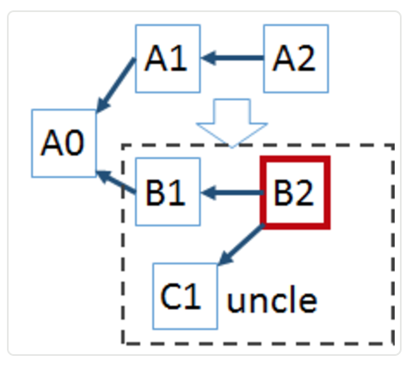
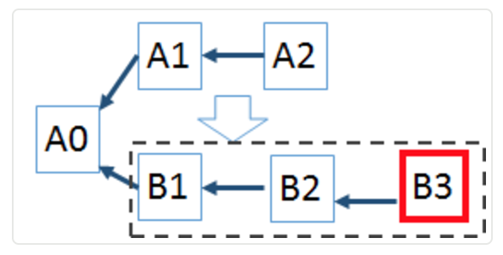
Tree
Orphan/stale blocks
2 nodes find a block at the same time
Propagated, verified, but eventually being cast off
Low inter-block time suffers from a high number of stale blocks
Ghost (Greedy Heaviest-Observed Sub-Tree)
Add stale blocks (uncles) into calculation of heaviest chain
^{Bitcoin}
^{Ethereum}
^{Longest chain}
^{Heaviest tree}
Notes:
An orphan or stale block, is created when 2 nodes find a block at the same time. This results in a tree of blocks.
Both found the solution to a block and send off their block to be verified and included in the blockchain. Usually completing blocks have different combinations of transactions.
But one of them eventually gets cast off as a longer chain achieved dominance.
In Bitcoin, the probability of finding a block at the same time is relatively low as the inter-block time is 10 minutes and propagating a block to 50% of the network takes roughly 12 seconds.
Whereas in Ethereum 1.0 miners are likely to make multiple competing blocks.
Therefore, Ethereum 1.0 used Ghost (Greedy Heaviest-Observed Sub-Tree) protocols to reference competing independently-mined blocks (aka uncle blocks), to add weight to their chain for its selection as the main chain.
This recognition of concurrent work allows shorter inter-block times which can improve the overall throughput of the blockchain system.

Slide 29
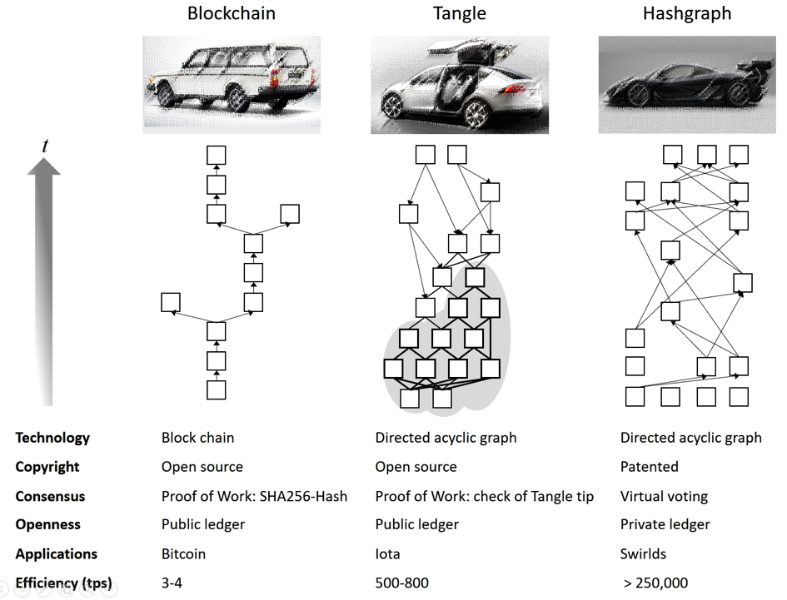
Directed Acyclic Graph (DAG) of Blocks/TXs
Global DAG
Logical view of transactions is based on a DAG of TXs or blocks
TXs – Tangle in IOTA
Blocks – Hashgraph in Hedera
Blockchain Tangle Hashgraph
 | Blockchain (Bitcoin) | IoTA | Hedera
Byzantine Toleration | 51% | 34% | 34%
Confirmation Time | 60 min (6-Confirmation) | Unstable | 5 sec
Notes:
The third option is to maintain a global Directed Acyclic Graph (DAG) of blocks or transactions.
The first figure shows the tree view of a blockchain (the most recent block at the top).
2nd figure is from IOTA, a platform that maintains a DAG of transactions rather than blocks. The proposed data structure is called Tangle.
In IOTA, a TX performs PoW by verifying that 2 previous transactions are valid. Once that transaction is confirmed by another transaction it is considered to be final. This also means time to finalise a transaction largely depends on how active the network is.
IOTA does not have transaction fees as each TX has to spend resources to validate 2 previous transactions.
3rd figure is a DAG of blocks, where a block points to 1 or 2 more previous blocks. This structure is called hashgraph and was introduced by Hedera.
Compared to Bitcoin, IOTA is more vulnerable, and can tolerate up to 34% power attacks (this is a theoretical attack that requires large computing power and grates visible on the major fraction of the DAG).
The confirmation time on Bitcoin is 60 minutes, the confirmation time on IoTA is unstable and mainly depends on how active the network is.

Slide 30
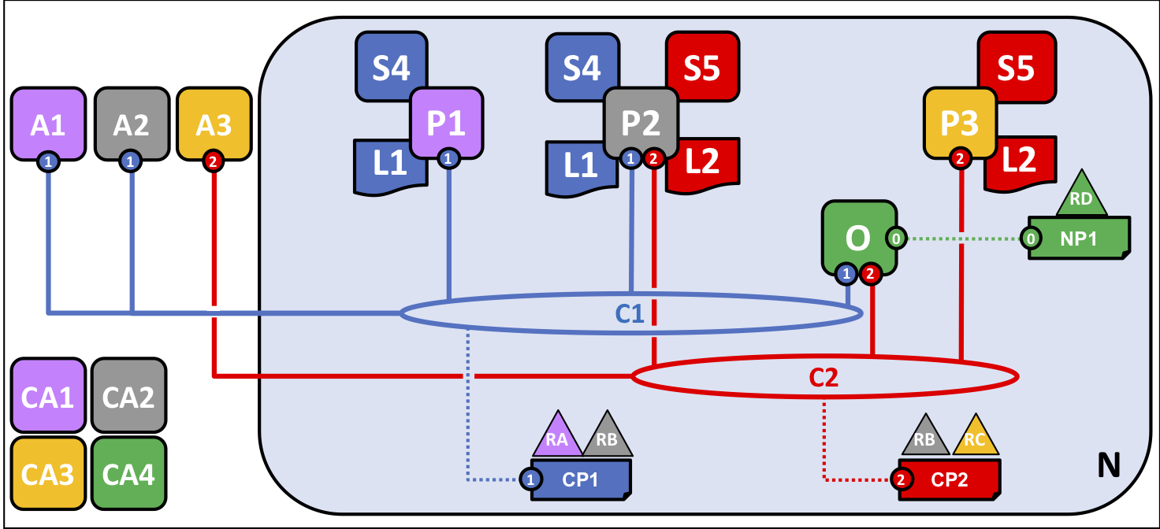
Peer-to-Peer Ledger
Hyperledger Fabric
A collection of small ledgers, aka channels
Isolate transactions within a channel
R3 Corda
Transactions are only distributed to parties of interest
Parties see a collection of small ledgers, shared with other business contacts
Abstract logic view is a global graph of transactions
Notaries are used to further limit transaction distribution
Attest to integrity of unseen parts of transaction graph
Source: Hyperledger Fabric Network
P1, P2, & P2 – Clients O – Ordering service
RA, RB, & RC – Organisations RARB & RBRC – Consortiums
C1 & C2 – Channels CP1 & CP2 – Channel policies
CA1 – CA4 – Certificate authorities
L1 & L2 – Ledgers
S4 & S5 – Chain code
Notes:
Hyperledger Fabric (HLF) maintains a collection of small ledgers, called channels, which can apply a more rigid transaction distribution policy that isolates transactions within the channels.
Transactions within a channel are visible to its members but not to others.
The diagram gives a simplified architecture of an HLF deployment with 4 organisations, each represented by a different colour.
Organization 1 and Organization 2 need private communications within the overall network through C1, as do Organization 2 and Organization 3 through C2.
Peer node P1 maintains a copy of the ledger L1 associated with C1.
Peer node P2 maintains a copy of the ledger L1 associated with C1 and a copy of ledger L2 associated with C2.
Peer node P3 maintains a copy of the ledger L2 associated with C2.
Channel C1 is governed according to the policy rules specified in channel configuration CC1; the channel is under the control of organizations R1 and R2.
Channel C2 is governed according to the policy rules specified in channel configuration CC2; the channel is under the control of organizations R2 and R3.
There is an ordering service O4 that serves as a network administration point for N and uses the system channel.
In R3 Corda, transactions are only distributed to parties of interest.
Most parties see a collection of small ledgers, each shared with their related business contacts involved in a transaction. Essentially, if 2 parties ever transacted once, it’s like having a ledger with only those 2 parties and only that transaction.
The abstract logical view of transaction history is a global graph of transactions.
Special agents (notaries) can be used to further limit the distribution of transactions while attesting to the integrity of unseen parts of the transaction graph.

Slide 31
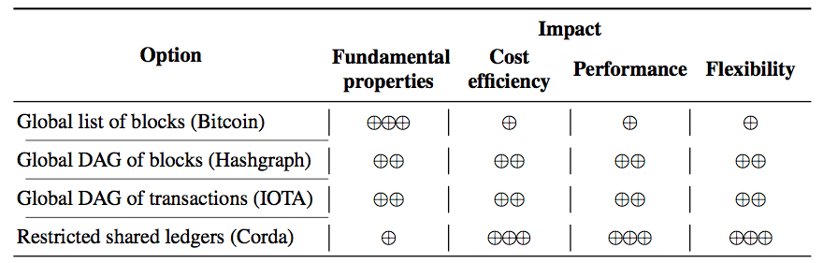
Ledger Structures Trade-Off Analysis
Single global TX history
Multiple small ledgers
Notes:
Here is a summary of trace-offs of different ledger structures.
A global list of blocks has most of the fundamental properties of blockchains (e.g., immutability and transparency), however, they come at the expense of performance, flexibility, and cost.
Whereas HLF and Corda’s approaches have better performance, flexibility, and cost efficiency, they compromise on fundamental properties.
DAGs sit in the middle.

Slide 32
Mining & Ledger Distribution
Notes:
Next, we talk about a few options that optimise or reuse mining or distribute ledger structures to gain enhance performance and cost efficiency

Slide 33








Mining Pools
Nonce
0, 1, 2, 3, 4, 5, …………..……………………., 2^{n}-1
Hash rate
Nonce range, m-bit block data
Mining Pool Manager
TX pool
Winning nonce
Header Construction
Partial proofs
Payout as per shares
New block
Next block
Pool difficulty < Block difficulty
Partial proof – Solution for puzzle with pool difficulty
1 partial proof = 1 share
Miners submit multiple partial poofs to increase share
Proves that miners are working to solve puzzle
n-2
n-1
n
n+1
Notes:
Given the massive amount of computing power needed to solve PoW, solo mining is unlikely to work. Therefore, miners pool their computing power to form a massive virtual computer.
A mining pool has a manager that it’s typically controlled by one or more parties.
As discussed earlier, as soon as a new block is received, the mining pool manager starts building the next block by including transactions from the transaction pool.
We can think of nonce as a large set of numbers. If the nonce is n-bit long there are 2^{n} nonces from 0 to 2^{n-1}. E.g., if n = 8 there are 256 nonces from 0 to 255.
As the nonce is very large it needs to be split and assigned to different miners. Only one of those nonces (or a few of them to be more accurate) will be the answer to the PoW puzzle.
As miners bring in disproportionate mining power, the nonce range needs to be split based on their computing capacity.
This is usually done based on an estimate of the number of hash calculations that a miner can perform for a unit of time. This is called the “hash rate”.
Higher the hash rate, the large the nonce range allocation.
A range of nonce values is then assigned to the miner. Similarly, other miners assigned their quota.
Suppose once the miners are successful in solving the puzzle. It reports that back to the pool manager.
The pool manager assembles the next block and propagates that to the rest of the network.
Mining reward and TX fees are assigned to the mining pool owner’s address. Which later transfers the payout to miners based on their contribution measured based on their “share” of contribution.
Share is measured based on the number and difficulty of partial proofs a miner submits.
Partial proofs (aka weak proofs) are answers to PoW puzzle with a slightly low difficulty level. E.g., if network difficulty requires you to find 16 leading zero bits, partial proof may require finding only 10 zero bits.
Miners are encouraged to submit multiple partial proofs to increase their share and show that they are mining.
Actual mining pools may behave slightly differently from this diagram. But the basic mechanism remains the same.
This idea can be extended to Proof of Stake blockchains, where miners pool their stakes.

Slide 34
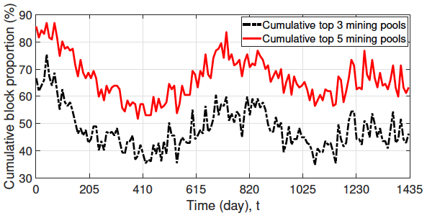
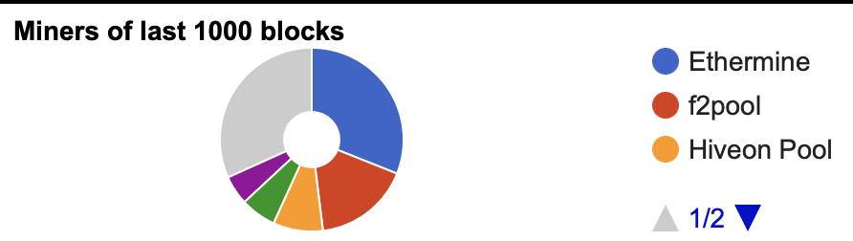
Mining Pools (Cont.)
Mining pools aggregate computational power
Better chance of solving PoW puzzle
Receive more consistent block rewards & TX fees to pool’s address
Distributed to pool members’ addresses as per their share
Pool manager sets business rules
Payout is usually subject to a fee
A few ways to game the system
Mining isn’t quite centralised, but pool decision making is
Feb 2016
Feb 2020
Source: C. Wang, X. Chu, and Y. Qin, Measurement and Analysis of the Bitcoin Networks: A View from Mining Pools, BigCom, 2020.
Notes:
Given high block difficulty solo mining may not work at all unless they were lucky in finding a nonce without much effort. But long-term this won’t work.
Mining pools aggregate computational power enhancing the chance of solving the PoW puzzle as a collective.
While even a mining pool may not be able to build a set of adjacent blocks, it may be able to build one in several blocks.
This increases the consistency of receiving a block reward and transaction fees.
As every pool member gets some reward as per their share, everyone receives a more consistent reward.
Most pools are managed by a few parties.
These parties usually charge a fee, e.g., 3-5% from the payout.
There are opportunities to game the system in terms of getting disproportionate shares or not paying certain miners.
An example attack is pool manager may not payout some miners.
One solution is for miners to share each other share information to double-check whether the pool manages payout properly, e.g., see https://en.bitcoin.it/wiki/P2Pool#Protocol_description
A bit more complicated issue is when the miner may have found the solution, but may try to find more partial proofs to increase the share before returning the correct proof to the pool. But miners risk the pool not being able to build the block before other pools.
Miners may find partial proof and stop further processing or jump to another pool. Miner gets some reward if another pool member gets the proof.
There are ways to mitigate some of these problems.
As we can see from the 2 figures, a few mining pools are responsible for most of the computing power in Bitcoin (top diagram) and Ethereum (bottom diagram from ethviewer.live)
While mining is still decentralised as computing power comes from many nodes, mining pool decision-making is quite centralised
This has implications for the security of the consensus process and collusion of a few mining pool manager may result in a 51% attack.

Slide 35
Merged Mining
Bootstrapping problem for new blockchains
Hard to attract enough computing power to maintain high block difficulty
For established blockchains, miners leaving for new ones is a problem
Fragmented computing power due to miner hopping or leaving for good
Merged mining solves both problems, while increasing miners’ income
Set sidechain’s block difficulty < Parent chain’s block difficulty
Build sidechain’s next block header
Include sidechain’s block header in parent chain as a TX (usually in coinbase TX)
Solve PoW puzzle on parent chain as usual
Accept a partial proof as answer to sidechain’s puzzle
Propagate next block on sidechain with partial proof & parent chain’s hash in header
Notes:
New blockchains are not able to accumulate a sufficiently large number of miners/computing power to have a high difficulty level to ensure their blockchain remains secure. This is called the bootstrapping problem.
Alternatively, the computing power of a well-established blockchain gets fragmented when miners hop between blockchains or leave for good.
Merged mining disincentive miners of large and established cryptocurrencies like Bitcoin to switch their mining activities to emerging cryptocurrencies where miners are given the possibility to continue mining on the established cryptocurrencies, while also generating profits in merge-mined child blockchains.
Merged mining – is the process of reusing partial/weak PoW solutions from a parent cryptocurrency as valid PoW for one or more child cryptocurrencies.
For new blockchains, merged mining provides access to the large computational capacities of established blockchains like Bitcoin.
A miner may merge mine for multiple child blockchains called “sidechains”.
Namecoin is the first blockchain that uses merged mining with Bitcoin.
For a parent cryptocurrency to allow merged mining it must be possible to include arbitrary data in a transaction.
A single parent blockchain can be used to perform merged mining on multiple sidechains by including the Merkle-tree root of a Merkle tree of the sidechain’s block hash.
At a high-level merged mining process include the following steps:
The first set sidechain’s block difficulty is a bit less than the Parent chain’s block difficulty.
Build the sidechain’s next block header by aggregating transactions and calculating Merkle root.
Next, include the sidechain’s block header in the parent chain as a TX. This is usually included in coinbase TX as that confirms the miner.
Solve the PoW puzzle on the parent chain as usual.
Accept a partial/weak proof that satisfies the sidechain’s difficulty as an answer to the sidechain’s puzzle (the parent chain’s answer is also an answer for the sidechain).
Finally, propagate the next block on the sidechain with its block data, block header which now contains partial proof and the parent chain’s hash in the header.
A good description of merged mining is given at https://alexeizamyatin.medium.com/a-technical-deep-dive-into-merged-mining-5b67706e1a19

Slide 36
Merged Mining Example
Block n
Block n+1
Block n+2
Block hash Previous hash Merkle root
Coinbase TX + Sidechain hash
TX 1
TX 2
…
Block hash Previous hash Merkle root
Coinbase TX + Sidechain hash
TX 1
TX 2
…
Block hash Previous hash Merkle root
Coinbase TX + Sidechain hash
TX 1
TX 2
…
Block hash Previous hash Merkle root
Coinbase TX + Sidechain hash
TX 1
TX 2
…
Block hash Previous hash Merkle root
Coinbase TX + Sidechain hash
TX 1
TX 2
…
Merged miner
Merged miner
Usual miner
Merged miner
Merged miner
Block hash Previous hash Merkle root
TX 1
TX 2
…
Block hash Previous hash Merkle root
TX 1
TX 2
…
Block hash Previous hash Merkle root
TX 1
TX 2
…
Block hash Previous hash Merkle root
TX 1
TX 2
…
Parent block hash
Parent block hash
Parent block hash
Parent block hash
Block m
Block m+1
Block m+2
Block m+3
Notes:
Here’s a simplified illustration of how merged mining works.
The first miner on the side chain builds a block based on the Merkle root of its set of transactions and the previous block’s hash. It then calculates the block hash.
The block hash is then included in the coinbase TX of the parent chain’s merged miner (the same node may build a block for both parent chain and sidechains or it could be 2 different nodes).
The parent blockchain miner then continues to solve the PoW puzzle as usual.
If the miner is successful, it will propagate the block on the parent chain.
At the same time, the parent chain’s hash (and also the Merkle tree root of the parent block to confirm coinbased TX) is included in the sidechain’s block.
Then the sidechain’s block is broadcasted to the sidechain. Anyone in the side chain can verify this block by checking with the parent chain.
Next, we look at an example where the parent chain’s merged miner is only able to solve the partial/weak puzzle.
As the partial proof is still valid due to the lower block difficulty in the sidechain, this nonce, and associated block data can be used to build the next block on the sidechain.
Here we assume a non-merged minder (i.e., a usual miner) was able to solve the puzzle for the parent chain. Hence, this information is not used to build the next block on the sidechain.
When it comes to the next round, we consider 2 scenarios.
In the first case, a merged miner was able to quickly find a partial proof based on which block m+2 was propagated on the sidechain.
In the second case, when the merged miner who was successful in solving the puzzle for the parent chain started building its block, it used the hash from block m + 3. Once it solves the puzzle its hash can be used to propagate block m+3 on the side chain.
Hence, it is possible to generate multiple blocks for a sidechain for a single block in the parent chain.

Slide 37
Merged Mining Pros & Cons
No change to parent chain protocol
Merged miner includes a (coinbase) TX with hash of sidechain block
Merge miner doesn’t attempt to validate sidechain block
Many mining pools merge-mine several sidechains, e.g., Ghash.IO: Bitcoin, Namecoin, IXCoin, Devcoin
Sidechain client
Construct header for sidechain & validate other sidechain blocks
Verify parent chain’s full or partial proof based on header
Append parent chain’s hash & propagate sidechain block
A small miner (or mining pool) on a large parent chain can ruin a sidechain
Increased centralisation issues in sidechain
Miner may mine on different branches of the same sidechain
E.g., CoiledCoin by Eligius pool (Jan 2012), TerraCoin by unknown (Jul 2013), WorldCoin by unknown (Nov 2013)
Notes:
Merge mining offer several advantages, but can also ruin a sidechain
From the parent chains point of view, it does not require any changes to the parent chain’s protocol
Merged miner just includes a (coinbase) TX with hash of sidechain block, or Merkel root if supporting multiple sidechains
Merge minder doesn’t attempt to validate sidechain block
Many mining pools merge-mine several sidechains, e.g., Ghash.IO: Bitcoin, Namecoin, IXCoin, Devcoin
Sidechain client is a bit more complicated
It needs to construct header for sidechain and share that the parent chain miner.
It also needs to validate other sidechain blocks
Verify parent chain’s full or partial proof based on header (usually parent chain’s transactions are not validated)
It then appends parent chain’s hash to new block and propagate the sidechain block to rest of the sidechain
However, things can go wrong as merged miner’s (or a mining pool) computing power may be too much given lower difficulty of sidechain
This could be seen as increasing centralisation concerns in sidechain
There’s also risk of a miner mining different branches of the sidechain. This way, miner can attack by preventing Nakamoto concerns or substantially delay it
There are several well-know examples of this going wrong
One of the well-known story is about an old coin called CoiledCoin, which was quite small
In 2012, and one of the large mining pools, Eligius in Bitcoin decided that CoiledCoin was a scam, and a bad idea.
Eligius pool pointed its massive computing resources at CoiledCoin and launched an attack.
The attack involved mining a lot of blocks that reversed days of TX history in CoiledCoin, reversing the user transactions. And as well as mining a long chain that had empty blocks containing no transactions. This is essentially a denial-of-service (DoS) attack.
CoiledCoin users weren’t able to make any transactions during that time.
After a fairly short time of the siege, all of the users of CoiledCoin had left and moved on, and the altcoin doesn’t exist anymore as such.
Merge mining makes it cheaper for attackers since the attackers don’t even have to stopping mining Bitcoin while it launches this attack.

Slide 38



Sharding
ID | Asset
Alice | 500
Bob | 1000
Charlie | 500
Dave | Plot 123 @ 2015
Sweet Mango | Bowen QUE, Org. Cert # 45781
Full nodes require sizeable storage space
Bitcoin > 460GB
Ethereum > 650GB full node, > 6TB archive node
Sharding
Divide ledger state into pieces
Participating blockchain nodes only hold some shards
Enable parallel transaction execution
TX sharding vs. State sharding
ID | Asset
Alice | 500
Bob | 1000
Dave | Plot 123 @ 2015
Sweet Mango | Bowen QUE, Org. Cert # 45781
ID | Asset
Alice | 500
Charlie | 500
Sweet Mango | Bowen QUE, Org. Cert # 45781
ID | Asset
Bob | 1000
Charlie | 500
Dave | Plot 123 @ 2015
Notes:
The full nodes of most blockchain networks need to keep all historical transactions and the ledger state, which requires sizeable storage space.
As of June 19, 2023, the Bitcoin ledger requires over 460 GB while Ethereum requires over 650 GB. If full state is maintained including transaction receipts an Ethereum node needs over 6 TB. See https://blockchair.com/bitcoin/charts/blockchain-size and https://blockchair.com/ethereum/charts/blockchain-size
These sizes keep growing.
To reduce the storage burden of blockchain participants and address other scalability concerns, the concept of sharding from databases is also being applied to blockchains.
The idea is to split the ledger into different fragments and keep multiple copies of fragments on some number of replicas. Each fragment is called a shard.
Transactions on a shard can run parallel to transactions on other shards increasing transaction throughput.
Sharding is quite complicated and nontrivial in blockchains. There are three types of sharding network, transaction, and state. We’ll next discuss the latter 2.

Slide 39

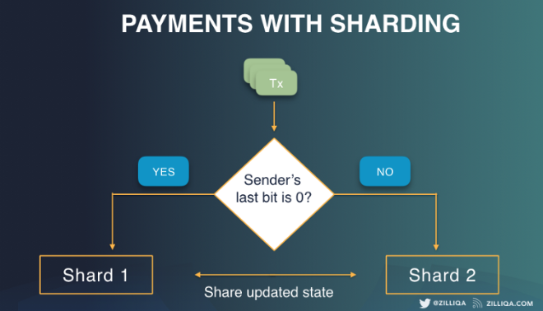
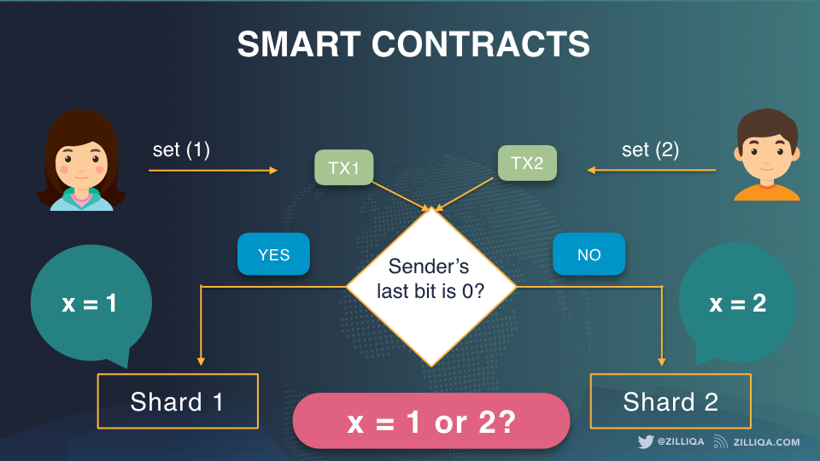
Transaction Sharding
Shard to execute transaction is determined based on sender’s address
Can prevent double spending
Doesn’t work well with smart contracts
Notes:
Zilliqa is a blockchain platform using sharing mechanism. Different transactions use different sharing strategies.
Here we look at transaction sharing where transaction sender’s address is used to determine which shards the transaction should apply.
To assign payment transactions in a network with two shards S1 and S2, we first check the sender’s address. If the address ends with 0, then it is assigned to S1. Otherwise, it is assigned to S2.
As all ledger state of an address stays in the same shard, this can prevent double-spending.
However, this doesn't work well with smart contracts .
Notice that the problem we are facing with smart contracts is like the one with regular payments when the transaction assignment strategy was based on the sender’s address. So on S1 we set the value to 1 while on S2 we set the value to 2. In this case, we should have selected the shard where the smart contract state is maintained. However, this is nontrivial as at the time of submitting a transaction we don’t know which ledger states it will access.
In the earlier case, the conflicting cases were on the sender’s state (i.e., balance), while with smart contracts, the conflicting cases are on the recipient’s state, i.e., the contract’s state.

Slide 40
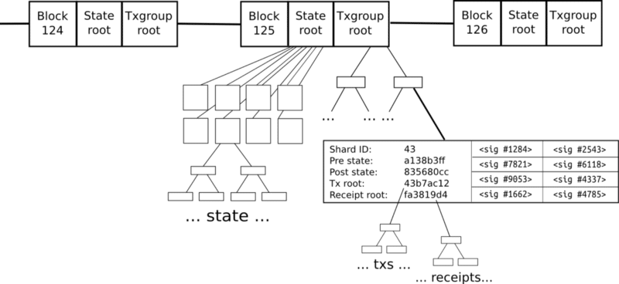
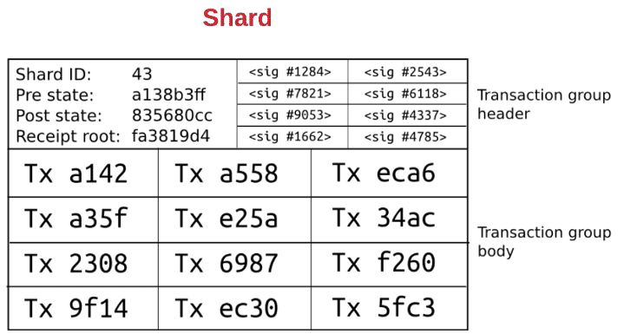
State Sharding in Ethereum 2.0 (Not in Road Map)
After sharding is activated
Ledger state is split into shards
Each account is in 1 shard
Accounts can easily transact with other accounts within same shard
2 levels of interaction
Random validator who needs to verify transactions in shard
Source: What are Ethereum Nodes And Sharding?
Notes:
Ethereum 2.0 was planing to improve scalability through sharding based on structuring the network into two layers. While details keept changing see https://blockgeeks.com/guides/what-are-ethereum-nodes-and-sharding/ for a good description. However, it seems Ethereum has dropped the idea of sharing and now focusing on Layer 2 solutions.
After sharding is activated, Ethereum 2.0 was supposed to use state sharding, i.e., sharding is based on ledger state than transaction sender’s address.
Imagine that Ethereum has been split into many islands. Each island can do its own thing. They were talking about at least 32 to 64 shards.
Each of the island has its own unique features and everyone belonging on that island i.e. The accounts, can interact with each other AND they can freely indulge in all its features.
If they want to contact with other islands, they will have to use some sort of protocol.
Each shard has its own group of a transaction. The transaction group is divided into the transaction group header and the transaction group body.
First level
Shard ID: The ID of the shard that the transaction group belongs to.
Pre-state root: This the state of the root of shard 43 before the transactions were applied.
Post state root: This is the state of the root of shard 43 after the transactions are applied.
Receipt root: The receipt root after all the transactions in shard 43 are applied.
Full of random validators who need to verify the transactions in the shard. They are randomly chose.
Top level
State root represents the entire state, broken into shards
Accept transaction groups rather than transactions
Transaction group is valid if 1) pre-state root matches the shard root in the global state and 2) signatures in the transaction group are all validated
After transaction gets in, the global state root becomes the post-state root of that shard ID

Slide 41
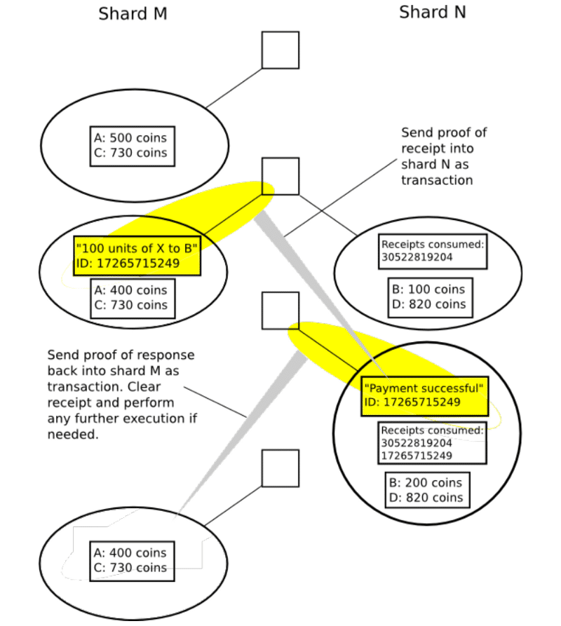
State Sharding in Ethereum 2.0 (Cont.)
Cross-shard communication
Receipt of TX can be accessed via multiple Merkle trees from the TX group Merkle root
Transaction does
Change the state of shard
Generate a receipt
Receipts are stored in a distributed shared memory
Seen by other shards, but not modified by them
Notes:
Here’s an example of a transaction that requires cross-shard communication.
Suppose 100 tokens are transferred from account A to B, which sits on 2 shards.
Transaction does change the state of the shard where account A resides (Shard M) and then generates a receipt.
Receipt of the transaction can be accessed via multiple Merkle trees from the transaction group Merkle root
Receipts are stored in a distributed shared memory and can be seen by other shards, but not modified by them.
Then seeing this receipt Shard N applies the other side of the transaction where the balance of B is updated.
This also generates a receipt that is made visible to Shard N.
This enables Shard M to finalise the transaction.
Things are more complicated if the transaction fails on Shard N where Shard M needs to revet its changes.

